Slide 1

Analysis
of
NYC Noise Complaints
Applied Data Science
Pratik P. Watwani (ppw220)

Slide 2
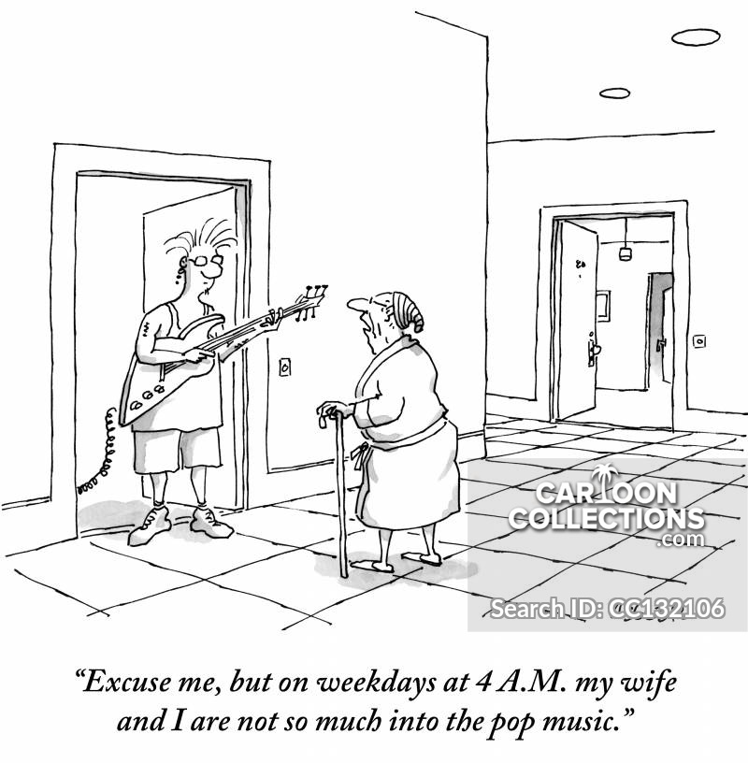
Introduction
“”
Since 2010, 1.1+ million complaints
related to noise have been reported

Slide 3
Types of noise
Environmental noise
Noise from neighbors
Indoor noise
mechanical noise
banging/pounding
…
construction noise
traffic noise
engine idling
...
loud music & party
barking dog
ice cream truck jingle
loud talking
...

Slide 4
Literature Review
Seasonal difference in noise complaints has been detected
Noise from neighbors are most frequent in zones between racially homogenous neighborhoods
Female are more sensitive to noise or intolerant to it than male by questionnaire research.

Slide 5
Objectives
Analyze the temporal features of 311 noise complaints
Explore potential factors, such as gender and race, of noise complaints, using demographic data, economic data, housing data and socio data

Slide 6
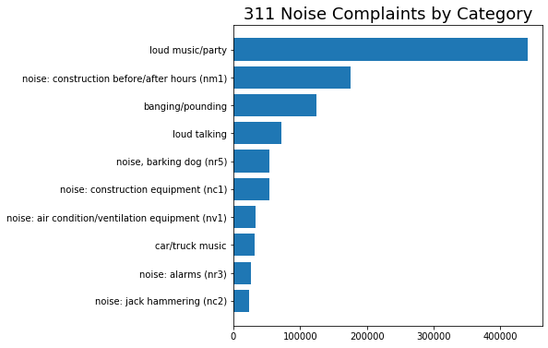
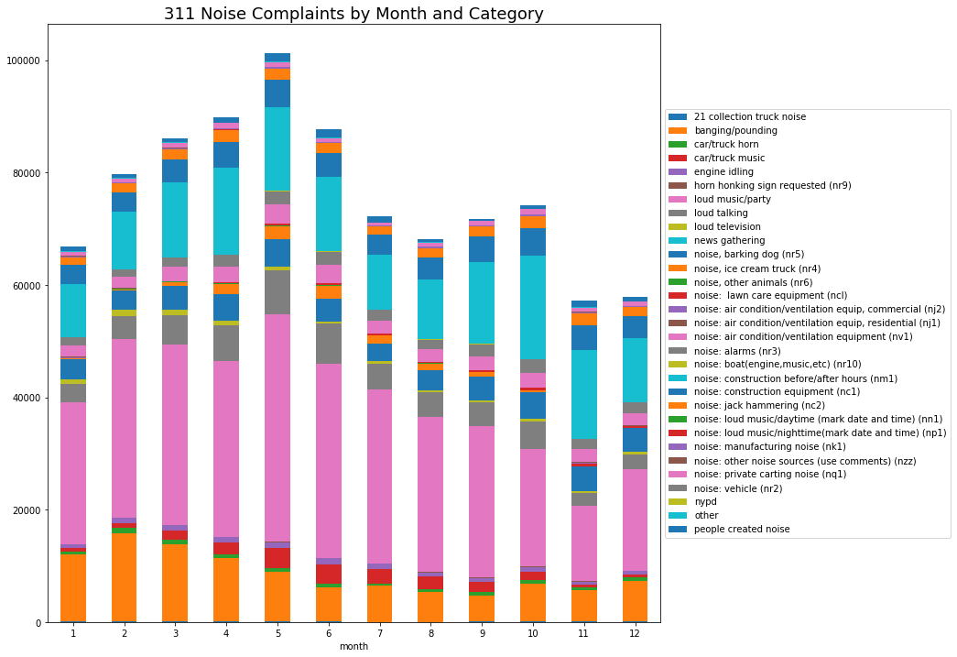
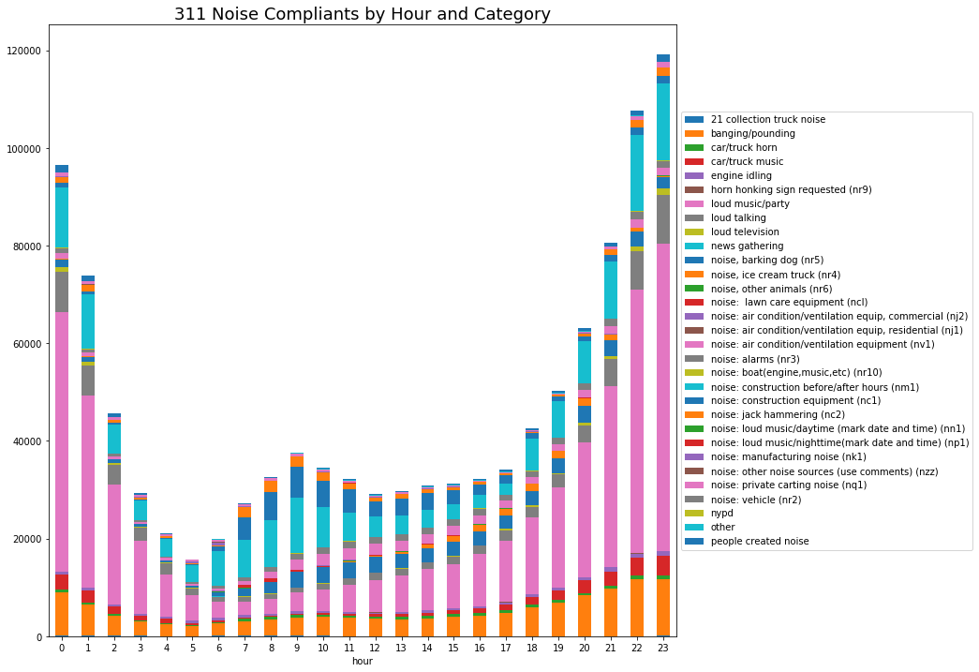
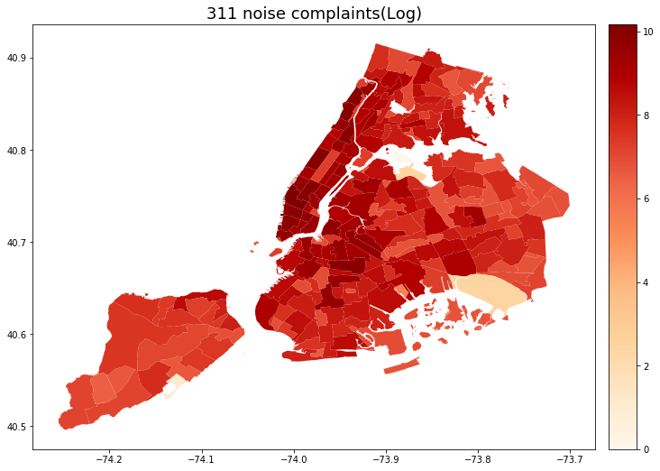
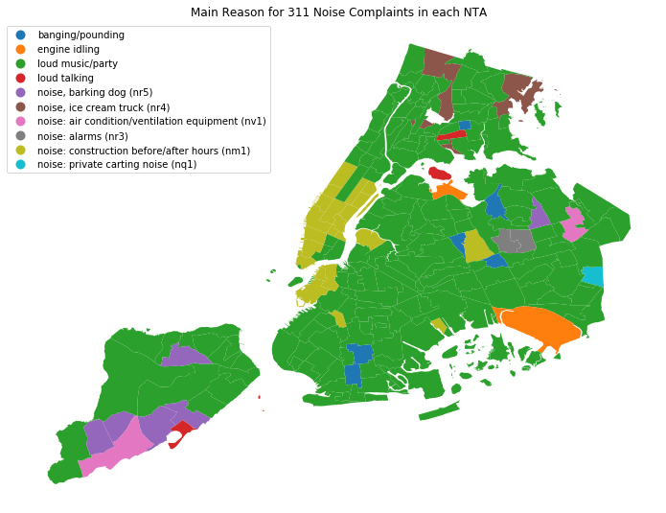
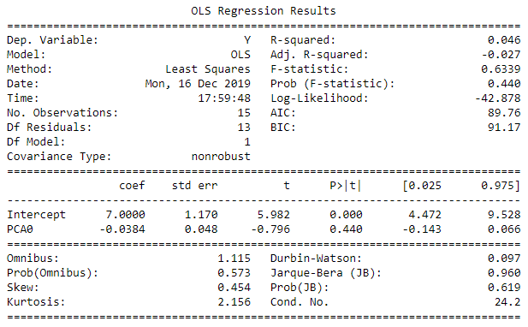
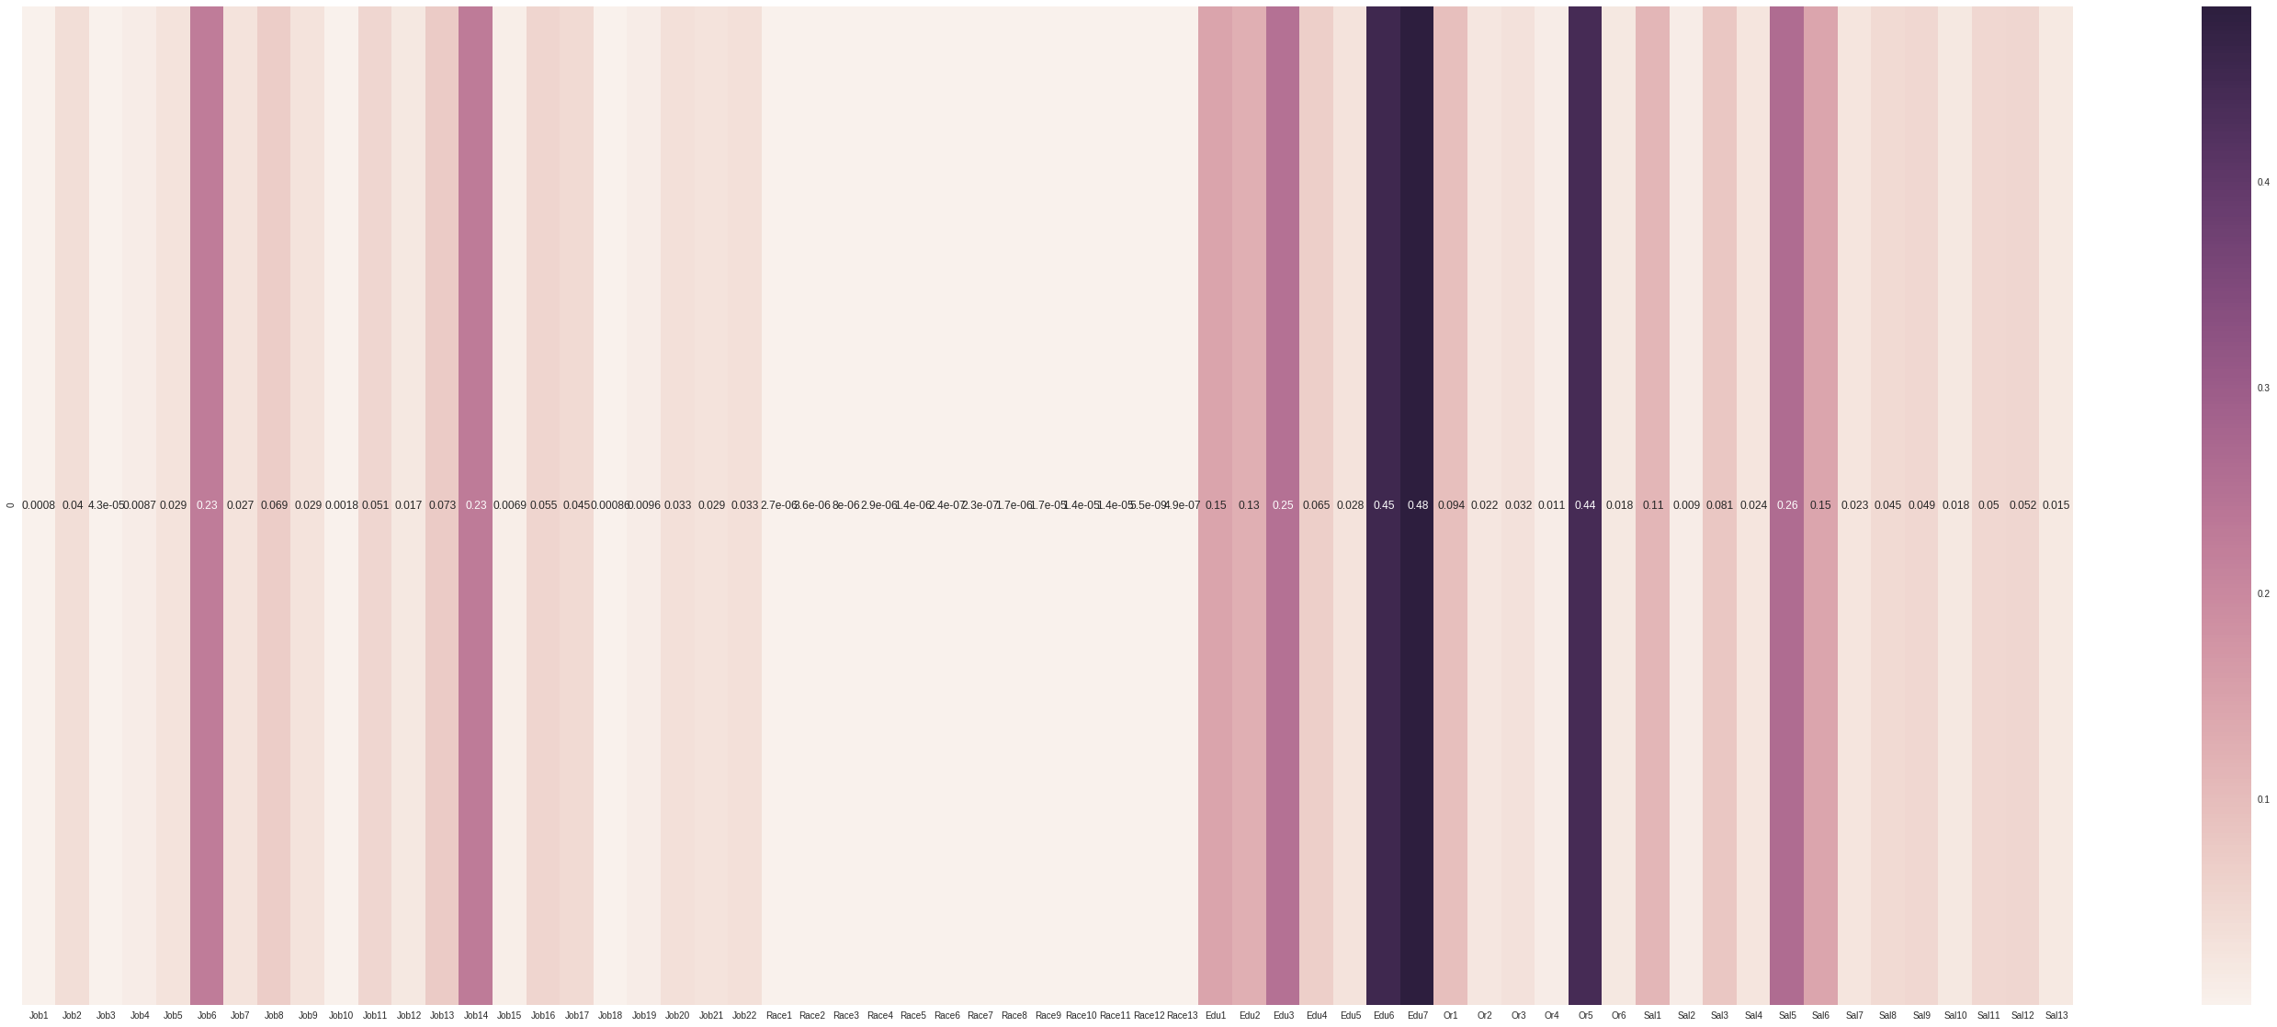
Methodology
EDA
By Category
Data Collection & Cleaning
311 Data
Time Series Analysis
by Month & Hour
Spatial Joint
Noise Complaints in each NTA
Spatial Analysis
at NTA level
Census Tracts Boundaries
Correlation Analysis
Demographics, Economy, Housing & Socio
Census Data
PCA
Regression

Slide 7
Data
ACS Economy Data
ACS Employment Data
ACS Salary Data
ACS Housing Data, and
NYC 311 Complaints Data
Stats:
100+ features
1.1M+ Noise Complaints
Data cleaning
Type conversion, string manipulation, eliminating redundancies, special characters, range check …

Slide 8
EDA

Slide 9
Temporal Analysis
Noise complaints are reported more frequently in summer
The decrease of winter noise complaints may be attributed to less loud music and party complaints

Slide 10
Temporal Analysis
Daytime vs Nighttime
Loud noises from neighbors and streetwalkers are less reported in daytime, while during night, party and social gatherings lead to an increase in noise nuisance
The construction noises are complained most around 9:00 am and midnight

Slide 11
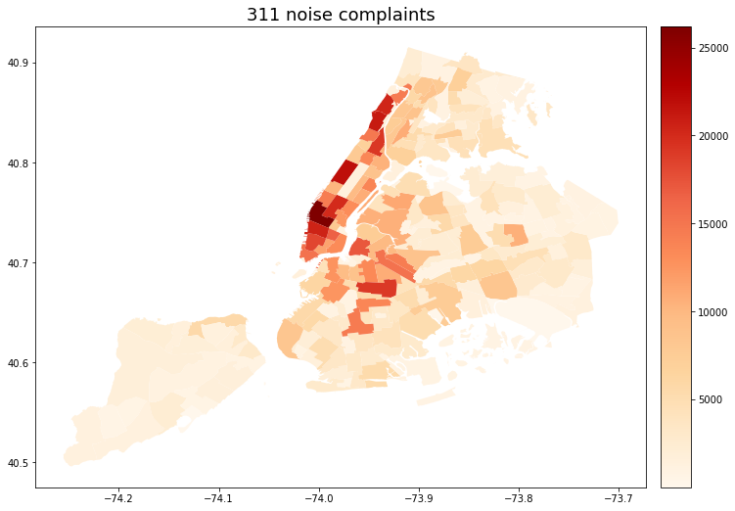
Spatial Analysis
Most noise complaints - Manhattan, especially the lower Manhattan, Upper West Side, Washington Height, and places around Downtown Brooklyn
Least noise complaints - JFK, LGA and the Great Kills Park in Staten Island
Complaints from park areas are significantly fewer than those from areas around the parks.

Slide 12
Spatial Analysis
In most areas, loud music and parties are the main sources of noise
Construction before/after hours comes to the second place among the reasons for noise complaints, mainly in Upper East, Upper West, Midtown, Lower Manhattan, Brooklyn Height, Red Hook, Kensington, Forest Hills, Starrett City

Slide 13
Spatial Analysis
JFK & LGA - Engine idling
Staten Island - Barking dogs
Bronx - Ice cream truck
(New York Botanical Garden, Bronx Zoo and Pelham Bay Park)

Slide 14
Demographic Characteristics
Education
Salary
Jobs
Origin
Race

Slide 15
Regression Analysis
Attributes
Armed Forces (J)
Government Workers (J)
Information (J)
Income Assisted (J)
Retired (J)
Associate Degree (E)
$200,000+ (S)
$150,000 - $199,999 (S)
. . . .
0.00
0.07
0.00
0.05
0.04
0.04
0.01
0.03

Slide 16

PCA and Regression
PCA analysis of attributes multiple attributes of Jobs, Education, Salary, and Country of Origin

Slide 17
Conclusion
Our study focuses on establishing a relationship between noise sensitivity and different demographic characteristics and how they affect the reporting sensitivity/tolerance.
Individually a lot of attributes were strong, collectively, only a small portion of them held a strong relationship.
Our analysis estimates Education and Origin factors taking the lead in the relationship, followed by Salary and Race.

Slide 18
Further Research
Incorporate an extensive range of demographic characteristics like Housing, Neighborhood, Area Type et cetera.
Drilled down analysis can be undertaken beyond NTA tracts, more precisely at BBL levels.

Slide 19
Thanks!
Any Questions?

